Slide 1
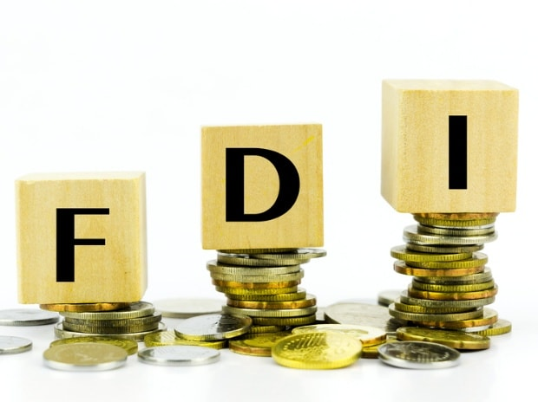
FOREIGN DIRECT INVESTMENT ANALYTICS
By MILI BHOWMIK

Slide 2
INTRODUCTION
Any investment from an individual or firm that is located in a foreign country into a country is called Foreign Direct Investment.
Generally, FDI is when a foreign entity acquires ownership or controlling stake in the shares of a company in one country, or establishes businesses there.
It is different from foreign portfolio investment where the foreign entity merely buys equity shares of a company.
In FDI, the foreign entity has a say in the day-to-day operations of the company.
FDI is not just the inflow of money, but also the inflow of technology, knowledge, skills and expertise/know-how.
It is a major source of non-debt financial resources for the economic development of a country.
FDI generally takes place in an economy which has the prospect of growth and also a skilled workforce.
FDI has developed radically as a major form of international capital transfer since the last many years.

Slide 3
Benefits of Foreign Direct Investment
Foreign direct investment offers advantages to both the investor and the foreign host country. These incentives encourage both parties to engage in and allow FDI.
Below are some of the benefits for businesses:
Market diversification
Tax incentives
Lower labor costs
Preferential tariffs
Subsidies

Slide 4
Benefits of FDI for the host country:
Foreign Direct Investment (FDI) can bring numerous benefits to the host country:
Capital Inflow: FDI brings in capital from foreign investors, which can be used to finance domestic investment projects, infrastructure development, and economic growth.
Job Creation: FDI often leads to the creation of new job opportunities in the host country, both directly through employment in foreign-owned enterprises and indirectly through the development of supporting industries and services.
Technology Transfer: Multinational corporations (MNCs) that invest in foreign countries often bring with them advanced technology, expertise, and management practices, which can help improve productivity and competitiveness in domestic industries.
Access to Global Markets: FDI provides access to international markets for host country firms through integration into global value chains and networks established by multinational corporations, facilitating exports and enhancing competitiveness.
Infrastructure Development: Foreign investors may contribute to the development of physical infrastructure such as roads, ports, and telecommunications networks, which can benefit not only their own operations but also the broader economy.

Slide 5
TYPES OF FDI
Foreign Direct Investment (FDI) can be classified into several types based on various criteria. Here are some common types:
1. Horizontal FDI: In this type, foreign direct investment occurs in the same industry in which the investor operates in its home country. For example, a car manufacturer in Japan investing in a car manufacturing plant in the United States.
2. Vertical FDI: This type of FDI involves investment in different stages of the production process across borders. It can be further divided into two subtypes:
Backward Vertical FDI: Investment in activities related to the earlier stages of the production process. For example, a clothing retailer in the United States investing in textile manufacturing plants in India.
Forward Vertical FDI: Investment in activities related to the later stages of the production process. For example, a car manufacturer in Germany investing in car dealership networks in Brazil.
3.Conglomerate FDI: In this type, the investor company operates in a completely different industry in the host country compared to its home country. For example, a technology company in South Korea investing in a real estate development project in the United States.
4. Greenfield Investment: This involves the establishment of a new business operation in the host country by the foreign investor, such as building a new factory or opening a new branch or subsidiary.
5. Mergers and Acquisitions (M&A): In this type, foreign direct investment occurs through the acquisition of an existing company or a significant portion of its assets in the host country. M&A can involve both domestic and foreign companies.
6. Joint Ventures : Foreign direct investment can also take the form of joint ventures, where a foreign investor partners with a local company to establish a new business entity in the host country. Joint ventures allow for sharing of resources, risks, and expertise between the partners.
These types of FDI can vary in terms of their motivations, risks, and impacts on the host country's economy and business environment.

Slide 6
TOP 10 SECTOR FDI
Sector | FDI(₹ Crores) | FDI(US$ Million)
Sector | FDI(₹ Crores) | FDI(US$ Million)
SERVICES SECTOR | 316426.67 | 59476.49
COMPUTER SOFTWARE & HARDWARE | 137296.48 | 24669.49
TELECOMMUNICATIONS | 131001.76 | 23946.01
CONSTRUCTION DEVELOPMENT | 115217.43 | 24293.09
AUTOMOBILE INDUSTRY | 92637.98 | 16673.92
TRADING | 84502.09 | 14210.88
DRUGS & PHARMACEUTICALS | 76411.49 | 14706.90
CHEMICALS (OTHER THAN FERTILIZERS) | 70068.76 | 13293.09
POWER | 60416.03 | 11589.13
CONSTRUCTION (INFRASTRUCTURE) ACTIVITIES | 60108.72 | 9817.47

Slide 7
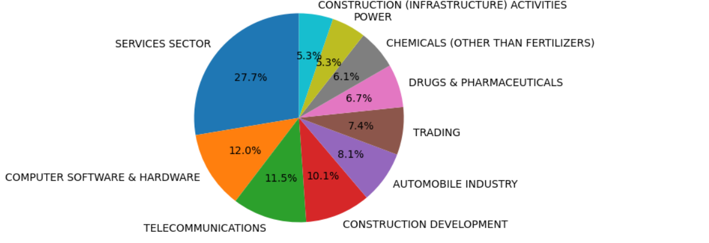
FDI in top 10 sector

Slide 8
BOTTOM 10 SECTOR FDI
Sector | FDI(₹ Crores) | FDI(US$ Million)
COIR | 21.64 | 4.06
DEFENCE INDUSTRIES | 26.12 | 5.12
MATHEMATICAL,SURVEYING AND DRAWING INSTRUMENTS | 41.62 | 7.98
COAL PRODUCTION | 122.13 | 27.74
PHOTOGRAPHIC RAW FILM AND PAPER | 278.37 | 67.28
INDUSTRIAL INSTRUMENTS | 369.28 | 76.12
DYE-STUFFS | 515.95 | 88.40
TEA AND COFFEE | 517.93 | 111.22
GLUE AND GELATIN | 818.53 | 128.39
LEATHER,LEATHER GOODS AND PICKERS | 903.78 | 167.20

Slide 9
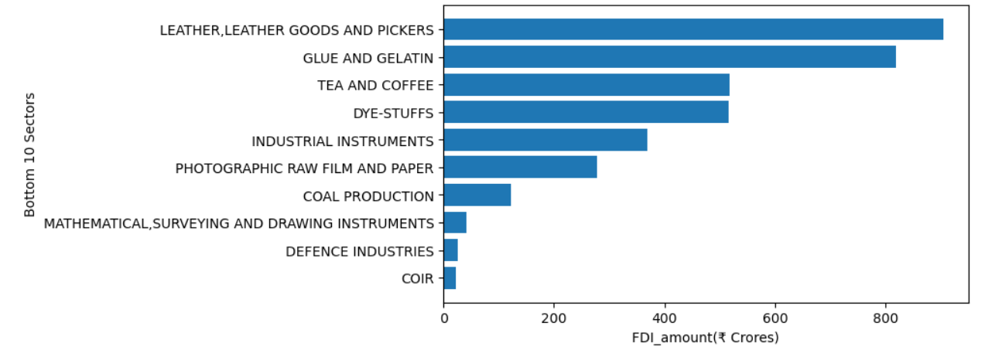
FDI in bottom 10 sectors

Slide 10
Variation of FDI INFLOW Year-wise
Year | FDI(₹ Crores) | % growth over previous year
2000-01 | 10865.97 | -
2001-02 | 19208.02 | 76.77
2002-03 | 13088.91 | -31.86
2003-04 | 10053.15 | -23.19
2004-05 | 14461.59 | 43.85
2005-06 | 24524.51 | 69.58
2006-07 | 56512.74 | 130.43
2007-08 | 98940.57 | 75.08
2008-09 | 144421.44 | 45.97
2009-10 | 122558.27 | -15.14
2010-11 | 97421.29 | -20.51
2011-12 | 168579.74 | 73.04
2012-13 | 122006.77 | -27.63
2013-14 | 147010.90 | 20.49
2014-15 | 189108.88 | 28.64
2015-16 | 261846.45 | 38.46
2016-17 | 291739.09 | 11.42

Slide 11
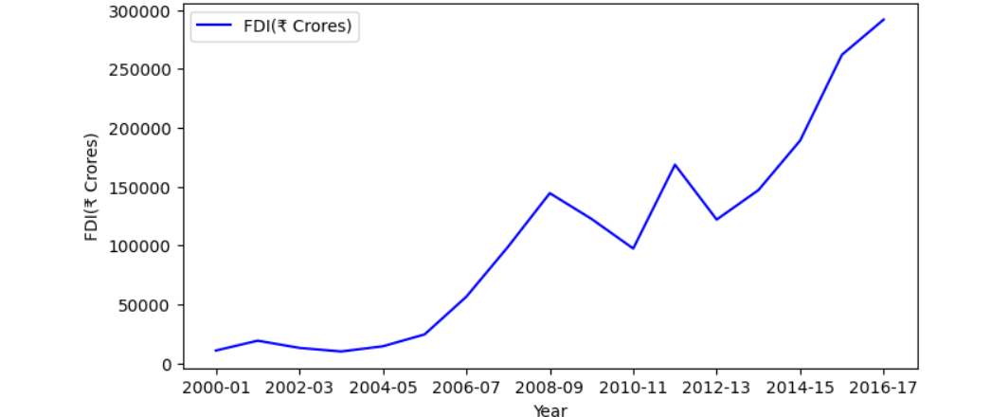
FDI Year by Year Inflow

Slide 12
CONCLUSION
The services sector has highest FDI among all the sector as it attracts the highest foreign direct investment (FDI) globally due to its potential for growth, relatively low capital requirements, and ability to generate high returns. This sector includes industries such as financial services, telecommunications, tourism, and business services, making it an attractive destination for foreign investors.
The coir sector has low levels of foreign direct investment (FDI) due to its reliance on traditional methods and local production. Compared to other sectors, such as manufacturing or technology, coir generally attracts minimal FDI due to its traditional and localized nature.
FDI has highest inflow in the year 2016-17.The inflow of foreign direct investment (FDI) into the industry can vary from year to year depending on factors such as market conditions,government policies,and global economic trends.

Slide 13
Thank You

